Slide 1
Java Web Development basis
-from Servlet To JSP
First10 Chapter Using Filters

Slide 2
learning target:
After studying in this chapter, you should:
Understand the basic principles of filters
Master filtering garbled codes through filters
Master the restriction of resource access through filters

Slide 3
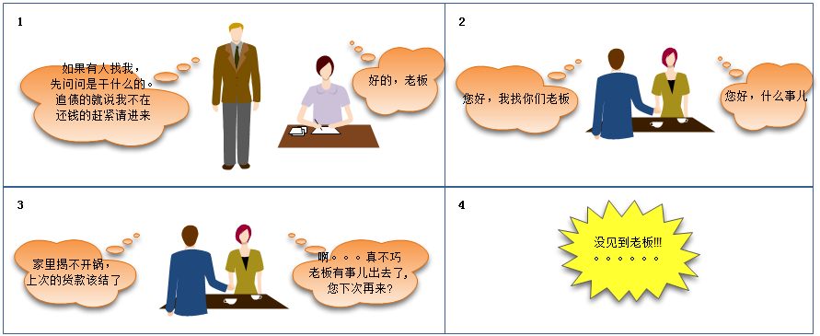
10.1 Filter overview
Before starting the learning of filters, let's look at two scenes in life. Take a look at the conversation between the boss and the secretary.
Life scene1--Intercept request

Slide 4
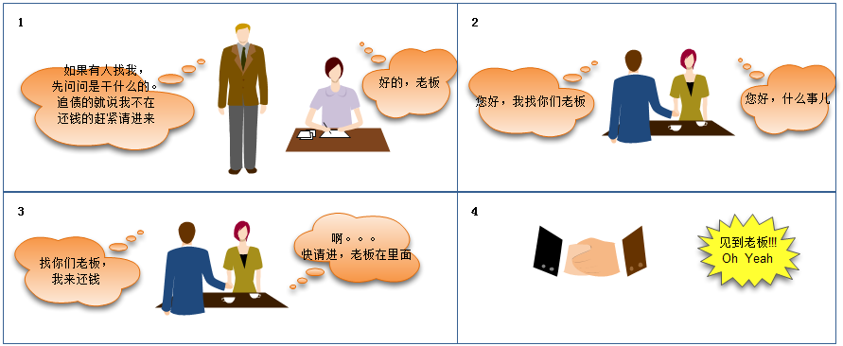
Life scene2--Release request
The secretary in the picture plays the role of a filter

Slide 5
The main task of the filter
Java EEThe filter in is executed in accordance with the rules and is automatically triggered once the conditions are met. It mainly completes two tasks:
Check the request object before the request is sent to the target, modify the request header and request content as necessary
Check the response object before the response is sent to the target, modify the response header and response content as needed

Slide 6
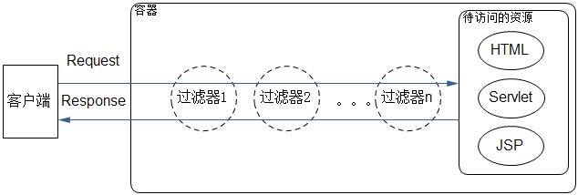
The basic principle diagram of the filter
There can be multiple filters to form a filter chain
Remarks: see the next page for the principle analysis

Slide 7
The basic principle of filter operation
Each filter is independent, and they can be configured to work together to form a filter chain.
In the filter chain, the container will determine the order of filter calls according to the filter configuration. If it reaches the end of the chain, it will transfer control to the resource to be accessed. When the resource is processed and needs to be responded to the client, the previous filter chain is passed in reverse order.
So how to set the trigger condition?
Where should I write the action that the filter should do after triggering?

Slide 8
10.2 Basic usage of filters
10.2.1 Implementation and deployment of filters
Filter and Servlet,JSP The same is a component on the server side, which runs in a container. From some places, Very similar.

Slide 9
 | Servlet | Filter
inherit/Implement the interface | Inherited fromHttpServletclass | AchievedFilterinterface
life cycle | initialization (transferinitmethod) | initialization (transferinitmethod)
 | Provide external services (transferServiceMethod byServiceCall the corresponding according to the request typedoXxxMethod, often calleddoGet/doPost) | Provide external services (transferdoFiltermethod)
 | Destroy the object (transferdestroymethod) | Destroy the object (transferdestroymethod)
write Servlet mainly overwrite doGet/doPostmethod;
When writing a filter, the main thing is to overwritedoFilter method.

Slide 10
 | Servlet | Filter
Deployment method1 (Use configuration files) | <servlet> <servlet-name>x</servlet-name> <servlet-class>x</servlet-class> </servlet> <servlet-mapping> <servlet-name>x</servlet-name> <url-pattern>/x</url-pattern> </servlet-mapping> | <filter> <filter-name>x</filter-name> <filter-class>x</filter-class> </filter> <filter-mapping> <filter-name>x</filter-name> <url-pattern>/x</url-pattern> </filter-mapping>
Deployment method2 (useAnnotation) | @WebServlet( name = "NewServlet", urlPatterns = {"/NewServlet"} ) | @WebFilter( filterName = "EncodingFilter", urlPatterns = {"/*"} )

Slide 11
Filter deployment issues (see next page for related issues)
A snippet of a filter deployment description file
<filter>
  <filter-name>x</filter-name>
  <filter-class>x</filter-class>
</filter>
<filter-mapping>
  <filter-name>x</filte-name>
  <url-pattern>/x</url-pattern>
  <dispatcher>REQUEST</dispatcher>
  <dispatcher>FORWARD</dispatcher>
  <dispatcher>INCLUDE</dispatcher>
  <dispatcher>ERROR</dispatcher>
</filter-mapping>

Slide 12
First1Question: How to describe a resource?
Usually<url-pattern>, Any resource can be abstracted into a<url-pattern>
First2Question: How to describe a certain filter?
Logical name that passed the filter<filte-name>, And the actual class corresponding to the logical name<filte-class>
First3Question: How to request resources
The requested method is passed<dispatcher>To describe. The default isREQUEST, No special instructions<dispatcher>, All pressREQUESTWay to deal with.

Slide 13
Use Annotation Way, also describes this 3 Aspects of the problem
@WebFilter(
  filterName = "x",
  urlPatterns = {"/x"}
  dispatcherTypes = {
    DispatcherType.FORWARD,
    DispatcherType.ERROR,
    DispatcherType.REQUEST,
    DispatcherType.INCLUDE
  }
)

Slide 14
10.2.2 Use filters in NetBeans
Goal: learn to useFilter,understandingFilterRunning process
Construction name:Example1001
Files used:
file name | Description
index.jsp | Simply rewrite the files that are automatically created when the project is created. Output prompt information on the console.
NewFilter1 | Manually createdFilter, Used to filterindex.jspAccess request.

Slide 15
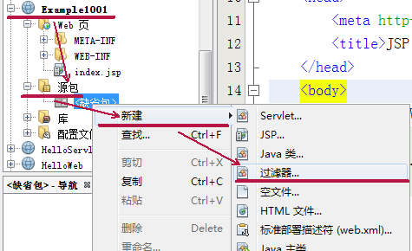
New filter

Slide 16
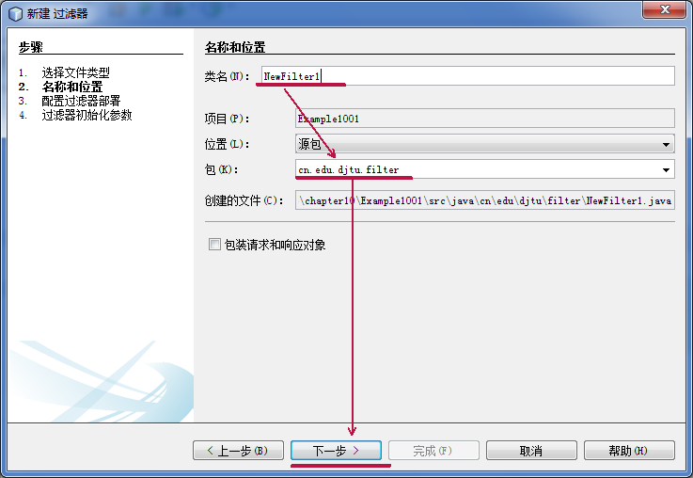
Set the name and location of the filter

Slide 17
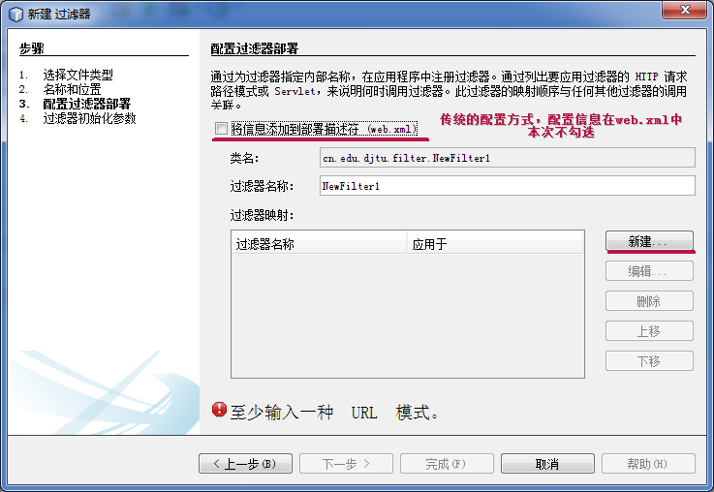
Configure filter deployment

Slide 18
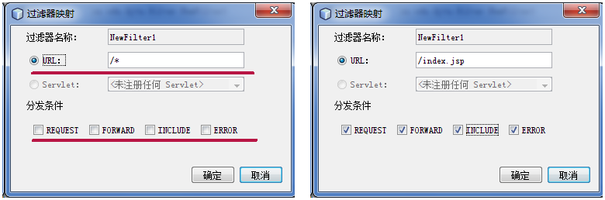
Configure filter mapping

Slide 19
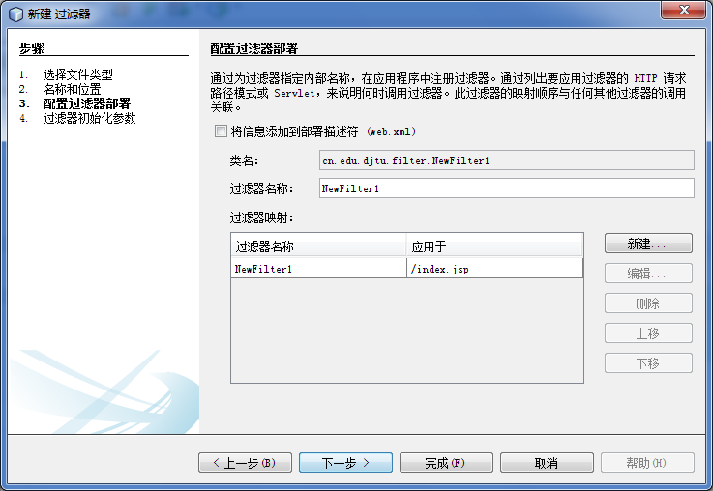
Set the name and location of the filter

Slide 20
index.jsp
<%@page contentType="text/html" pageEncoding="UTF-8"%>
<!DOCTYPE html>
<html>
<head>
<meta http-equiv="Content-Type" content="text/html; charset=UTF-8">
<title>JSP Page</title>
</head>
<body>
  <h1>Hello World!</h1>
  <%
    System.out.println("index.jsp");
  %>
</body>
</html>

Slide 21
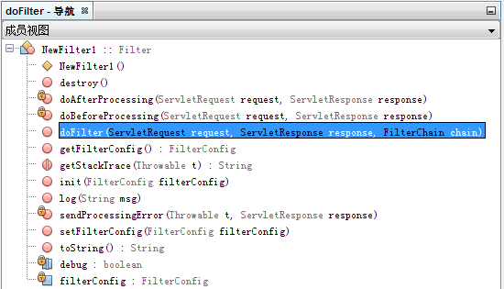
Methods and properties in filters

Slide 22
doFilterCode snippet
public void doFilter(ServletRequest request, ServletResponse response,FilterChain chain)
throws IOException, ServletException {
  //Code slightly
    doBeforeProcessing(request, response);
  //Code slightly
  try {
    chain.doFilter(request, response);
  } catch (Throwable t) {
  //Code slightly
  }
    doAfterProcessing(request, response);
  //Code slightly
}

Slide 23
Tochain.doFilter(request, response);For the world:
chain.doFilter(request, response);Previously, the request was filtered
chain.doFilter(request, response);After that, the response is filtered
chain.doFilter(request, response);Specifies to call the next filter in the filter chain.
NetBeansRespectively defined in
doBeforeProcessing(request, response);
doAfterProcessing(request, response);
Two methods to accomplish the task, these two methodsIs notFilterMethods in the interface.

Slide 24
NewFilter1ofdoFiltermethod(Snippet)
In NewFilter1 do Filter Add code , console
output statement
public void doFilter(ServletRequest request, ServletResponse response,FilterChain chain)throws IOException, ServletException {
//Code slightly
  doBeforeProcessing(request, response);
//Code slightly
try {
  System.out.println("inNewFilter1ofchain.doFilter(request, response);Before the statement");
  chain.doFilter(request, response);
  System.out.println("inNewFilter1ofchain.doFilter(request, response);After the statement");
} catch (Throwable t) {
  //Code slightly
}
  doAfterProcessing(request, response);
  //Code slightly
}

Slide 25
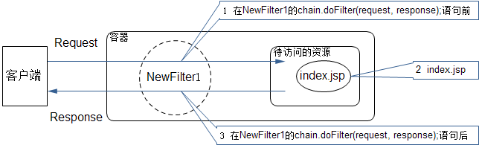
Example1001Expected order of execution

Slide 26
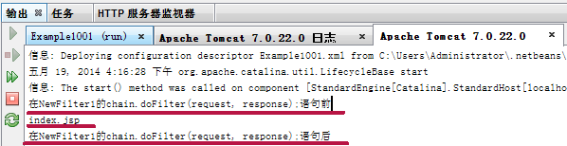
The actual output from the console
Observe the console output and you can see
that it is consistent with expectations

Slide 27
10.2.3 Order of filter execution
When multiple filters are mapped to the same given resource, what is the order
in which the filters are executed?
1. Create 2 more filters in Example1001, named NewFilter0, NewFilter2
2,NewFilter0The filter mapping willURLSet as"*.jsp"
3.NewFilter2The filter mapping willURLSet as"/*"

Slide 28
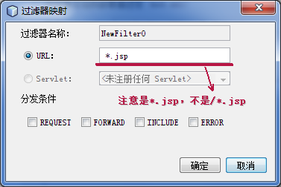
Set the URL in the filter mapping of NewFilter0 to "*.jsp". It means that all url-pattern visits ending with ".jsp" will pass this filter, for example: a.jsp, b.jsp, c.action.jsp.
ConfigurationNewFilter0Filter mapping

Slide 29
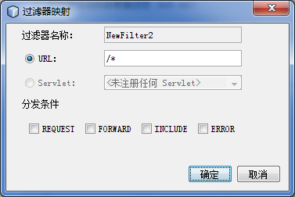
Set the URL to "/*" in the filter mapping of NewFilter2. It means that all requests will go through the filter, for example: a.action, NewServlet, c.jsp, d.html.
ConfigurationNewFilter2Filter mapping

Slide 30
New Filter of do Filter method(Snippet)
public void doFilter(ServletRequest request, ServletResponse response,FilterChain chain)
throws IOException, ServletException {
//Code slightly
doBeforeProcessing(request, response);
//Code slightly
try {
System.out.println("inNewFilter0ofchain.doFilter(request, response);Before the statement");
chain.doFilter(request, response);
System.out.println("inNewFilter0ofchain.doFilter(request, response);After the statement");
} catch (Throwable t) {
//Code slightly
}
doAfterProcessing(request, response);
//Code slightly
}

Slide 31
New Filter2 of doFilter method(Snippet)
public void doFilter(ServletRequest request, ServletResponse response,FilterChain chain)
throws IOException, ServletException {
//Code slightly
doBeforeProcessing(request, response);
//Code slightly
try {
System.out.println("inNewFilter2ofchain.doFilter(request, response);Before the statement");
chain.doFilter(request, response);
System.out.println("inNewFilter2ofchain.doFilter(request, response);After the statement");
} catch (Throwable t) {
//Code slightly
}
doAfterProcessing(request, response);
//Code slightly
}

Slide 32
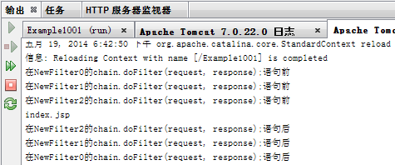
runindex.jsp, Observe the console output, you can see that the order of execution of the three filters isNewFilte0,NewFilte1,NewFilte2,

Slide 33
Filter execution order
Filter has 2 deployment methods: deployment method 1 (using configuration files) and deployment method 2 (using Annotation). The order of execution is different for the two deployment methods.
When deploying using a configuration file, the order of execution is the order in which it appears in the configuration file.
When using Annotation to deploy, the execution order is executed in the order of file name.

Slide 34
When configuring filter mapping, you can also followServletTo filter, if you have set theURLWay to filter, also set up byServletWay to filter, then the order of execution is to match firstURLPut all the filters in the chain, and then matchservlet-nameThe filters are put into the chain to form a chain together.

Slide 35
10.3 Use filters to solve real problems
10.3.1 Use filters to deal with Chinese garbled characters
We have previously learned a solution to Chinese garbled characters, this method can solve the garbled characters of the request information submitted by users in Chinese (Note: information submitted by post)
request.setCharacterEncoding("UTF-8");
The disadvantage is that the sentence needs to be written multiple times when it is used. Use filters to centralize processing, instead of writing the same processing sentence multiple times.

Slide 36
Goal: useFilterSolve Chinese garbled
Construction name:Example1002
Files used:
file name | Description
index.jsp | Simply rewrite the files that are automatically created when the project is created. Output prompt information on the console.
EncodingFilter | Manually createdFilter, Used to filter Chinese garbled characters.

Slide 37
Encoding Filter of doFilter method(Snippet)
public void doFilter(ServletRequest request, ServletResponse response,FilterChain chain)
throws IOException, ServletException {
//Code slightly
  doBeforeProcessing(request, response);
//Code slightly
try {
  request.setCharacterEncoding("UTF-8");
  chain.doFilter(request, response);
} catch (Throwable t) {
//Code slightly
}
  doAfterProcessing(request, response);
//Code slightly
}
EncodingFilterofURLSet as"/*", Other options take default values

Slide 38
10.3.2 Use filters to complete unified verification of users
If some resources on your site are not completely open and are only visible to registered users; or your site settings must be logged in before you can access, then you need to verify the user's identity. Users are required to log in before they can access the resources of the site.

Slide 39
Business logic of user login
The user enters the user name and password on the login page. If login is allowed, the user name is stored in the session object (session), and the request is forwarded to the home page; if login is not allowed, the error message is stored in the request field , Forward the request to the login page.
(See the next page for the log-in business logic flow chart)

Slide 40
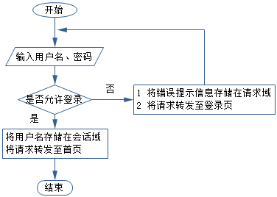
Log in business logic flow chart

Slide 41
The business logic of the filter processing request
When receiving a user's request, first obtain the requested path, then fetch the user name from the session domain, and then determine whether to let it go according to the conditions. If it is the login page, login processing component, error page, or the user name retrieved from the session domain is not empty, let it go. Otherwise, the request will be redirected to the error page, and an error message will be displayed on the page. The page is also accompanied by a link to the login page. After 3 seconds, it will automatically jump to the login page.
(See the next page for the business logic flow chart of the filter processing request)

Slide 42
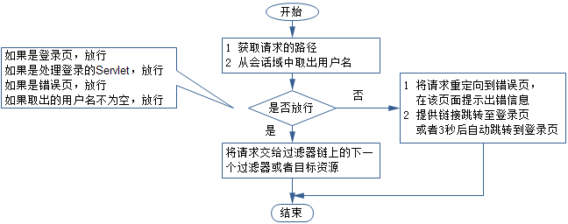
Flow chart of business logic for filter processing request

Slide 43
In order to make the model as simple as possible, the user login verification here does not connect to the database. Assuming the user name is "Zhang San" and the password is "111111", just a simple judgment is made. In this way, you can also test the Chinese garbled filter in Example1002 by the way, because both are filtered for all requests ("/*").

Slide 44
Goal: useFilterSolve the user's unified authentication problem
Construction name:Example1003
Files used:
file name | Description
index.jsp | Simply rewrite the files that are automatically created when the project is created. Output "Welcome:" on the page+username.
login.jsp | Manually createdJSPPage, including a form for submitting user name and password information toLoginServlet
error.jsp | Manually createdJSPOn the page, the error message "You have not logged in, please log in again" is displayed on this page, and a link is attached to jump to the login page. And set3Automatically jump to the login page in seconds.
LoginServlet.java | Manually createdServlet, Obtain the user name and password information submitted by the user, determine whether it is a legitimate user, if it is a legitimate user, store the user’s user name in the request field, and forward the request toindex.jsp
LoginFilter.java | Manually createdFilter, Used to filter Chinese garbled characters and user requests for resources.

Slide 45
login.jsp
<body>
  ${msg}
  <form action="LoginServlet" method="POST">
    username:<input type="text" name="username" value="" /><br/>
    password:<input type="password" name="userpass" value="" /><br/>
    <input type="submit" value="log in"/>
  </form>
</body>

Slide 46
LoginServlet.java(code segment)
protected void processRequest(HttpServletRequest request, HttpServletResponse response)throws ServletException, IOException {
  response.setContentType("text/html;charset=UTF-8");
  PrintWriter out = response.getWriter();
try {
  String username=request.getParameter("username");
  String userpass=request.getParameter("userpass");
  if ("Zhang San".equalsIgnoreCase(username)&&"111111".equals(userpass)) {
    HttpSession session=request.getSession();
    session.setAttribute("username", username);
    request.getRequestDispatcher("index.jsp").forward(request, response);
  } else {
    request.setAttribute("msg", "Login failed, user name and password are wrong!");
    request.getRequestDispatcher("login.jsp").forward(request, response);
  }
} finally {
  out.close();
}
}

Slide 47
index.jsp
<%@page contentType="text/html" pageEncoding="UTF-8"%>
<!DOCTYPE html>
<html>
<head>
<meta http-equiv="Content-Type" content="text/html; charset=UTF-8">
<title>JSP Page</title>
</head>
<body>
  <h1>Welcome:${username}</h1>
</body>
</html>

Slide 48
error.jsp
Then completeerror.jspPage, especially with<meta>The mark realizes the automatic
refresh of the page.
<meta http-equiv="refresh" content="3;url=login.jsp">
<%@page contentType="text/html" pageEncoding="UTF-8"%>
<!DOCTYPE html>
<html>
<head>
<meta http-equiv="Content-Type" content="text/html; charset=UTF-8">
<meta http-equiv="refresh" content="3;url=login.jsp">
<title>JSP Page</title>
</head>
<body>
  <h1>You have not logged in, please log in and then visit!</h1>
  3Jump to the login page in seconds, if your browser is not redirected, please click the link
  <a href="login.jsp">Go to login page</a>
</body>
</html>

Slide 49
LoginFilter.java
First complete the processing of Chinese garbled sentences
request.setCharacterEncoding("utf-8");

Slide 50
Take a lookdoFilterMethod parameters, you can see that the types of request and response objects are ServletRequest with ServletResponse.
Servle tofprocessRequestIn the parameters, the types of request and response objects are HttpServletRequest,HttpServletResponse.
In doFilter, you need toServletRequest Coerced to HttpServletRequest,willServletResponse Coerced to HttpServletResponse
HttpServletRequest req = (HttpServletRequest) request;
HttpServletResponse resp = (HttpServletResponse) response;

Slide 51
Get the user's current request when submittingURL
String path = req.getServletPath();
Retrieve the username from the requested domain
HttpSession session = req.getSession();
String username = (String) session.getAttribute("username");
Determine if it is a specific page orServlet
boolean b1 = path.endsWith("login.jsp");
boolean b2 = path.endsWith("error.jsp");
boolean b3 = path.endsWith("LoginServlet");

Slide 52
Determine if the username isnull
boolean b4 = (username != null);
If it is a specific page orServlet, Or the username is not empty, that isb1,b2,b3,b4If any one of the conditions is true, then let go directly; otherwise, redirect toerror.jsp.
if (b1 || b2 || b3 || b4) {
  chain.doFilter(request, response);
} else {
  resp.sendRedirect("error.jsp");
}

Slide 53
LoginFilter.java of doFiltermethod(Snippet)
public void doFilter(ServletRequest request, ServletResponse response,FilterChain chain)throws IOException, ServletException {
  doBeforeProcessing(request, response);
try {
  request.setCharacterEncoding("utf-8");
  HttpServletRequest req = (HttpServletRequest) request;
  HttpServletResponse resp = (HttpServletResponse) response;
  String path = req.getServletPath();
  HttpSession session = req.getSession();
  String username = (String) session.getAttribute("username");
  boolean b1 = path.endsWith("login.jsp");
  boolean b2 = path.endsWith("error.jsp");
  boolean b3 = path.endsWith("LoginServlet");
  boolean b4 = (username != null);
  if (b1 || b2 || b3 || b4) {
    chain.doFilter(request, response);
  } else {
    resp.sendRedirect("error.jsp");
  }
} catch (Throwable t) {}
  doAfterProcessing(request, response);
}

Slide 54
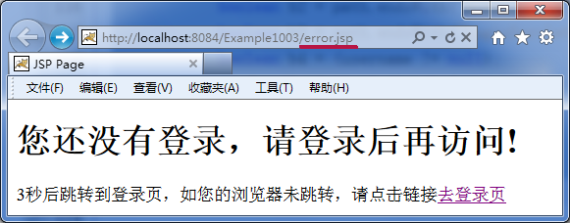
runindex.jsp, Because I was not logged in, I was redirected toerror.jsp,3After a few seconds, you will be redirected to the login page. Explain that the code in the filter that performs unified authentication on the user works.
Access when not logged inindex.jspbe rejected

Slide 55
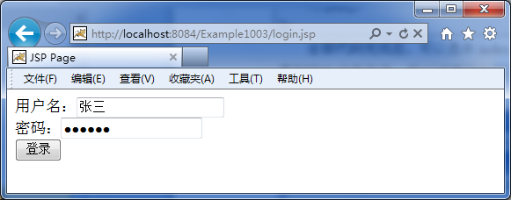
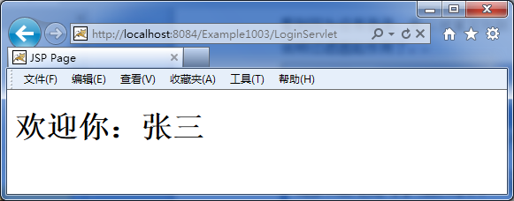
Enter the correct user name and password on the login page, here is the information in Chinese
After clicking login, a prompt message appears, indicating that the Chinese garbled sentences in the filter are effective.

Slide 56
Homework problems
[1].The main function of the filter?
[2].Filter withServletWhat is the difference and connection?
[3].When writing a filter, in which method do you generally implement your business logic? (Write the method name and parameters)
[4].How many ways are there to deploy filters? What are they? It is a combination of code examples.

